Slide 1
Linear models: a classic example

Slide 2
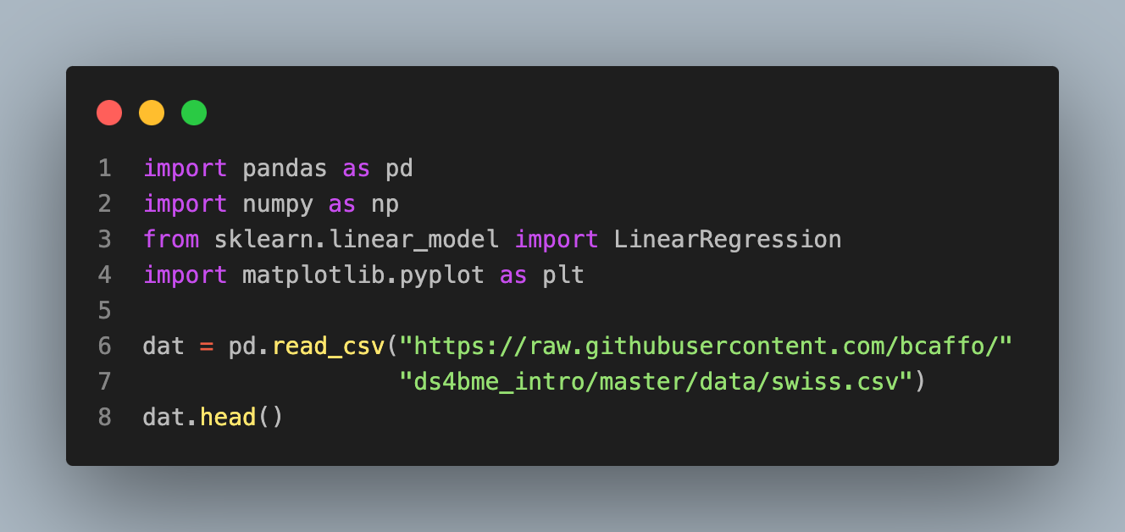
 | Region | Fertility | Agriculture | Examination | Education | Catholic | Infant.Mortality
0 | Courtelary | 80.2 | 17.0 | 15 | 12 | 9.96 | 22.2
1 | Delemont | 83.1 | 45.1 | 6 | 9 | 84.84 | 22.2
2 | Franches-Mnt | 92.5 | 39.7 | 5 | 5 | 93.40 | 20.2
3 | Moutier | 85.8 | 36.5 | 12 | 7 | 33.77 | 20.3
4 | Neuveville | 76.9 | 43.5 | 17 | 15 | 5.16 | 20.6

Slide 3
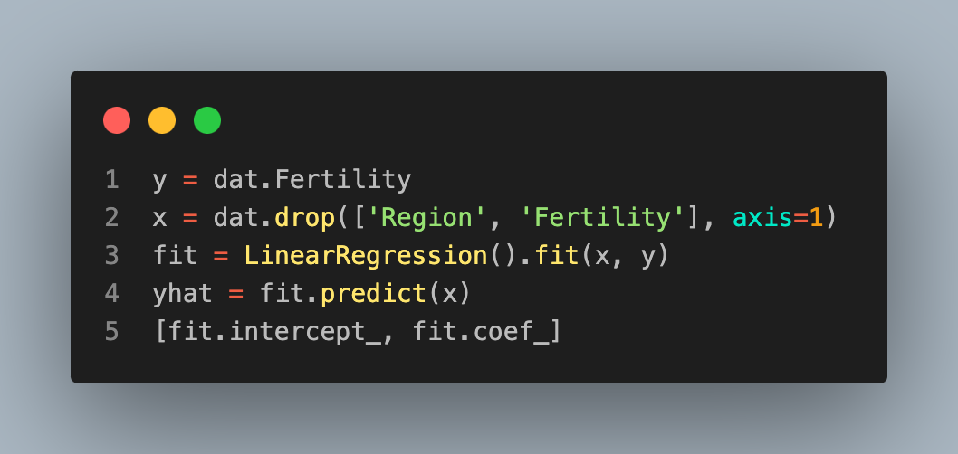
[66.91518167896871,
array([-0.17211397, -0.25800824, -0.87094006, 0.10411533, 1.07704814])]

Slide 4
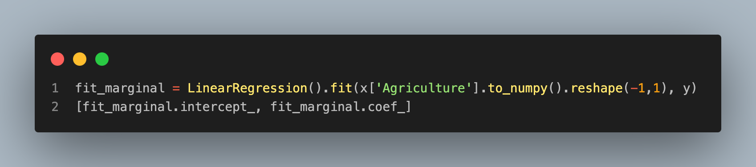
Example of adjustment effect
[60.304375228005725, array([0.19420175])]

Slide 5
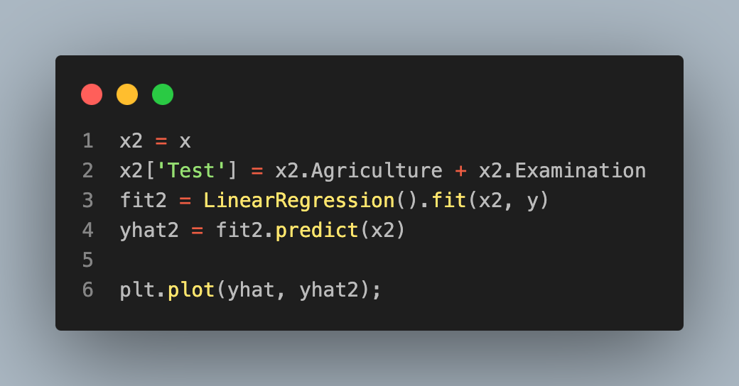
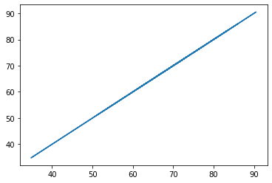
Adding a useless regressor does what?

